Slide 1

Password Cracking with Linux
CSCI 352 Semester Project
Whitney Carpenter | Jacob Nagle | Andrew Taylor

Slide 2

What is “Password Cracking”
The act of recovering or guessing a password used to protect a computer, user account, or sensitive data
It can be performed ethically, such as during penetration testing or legitimate attempts to recover access to a device
It can also be used unethically to gain unauthorized access to systems, often as part of a cyberattack

Slide 3
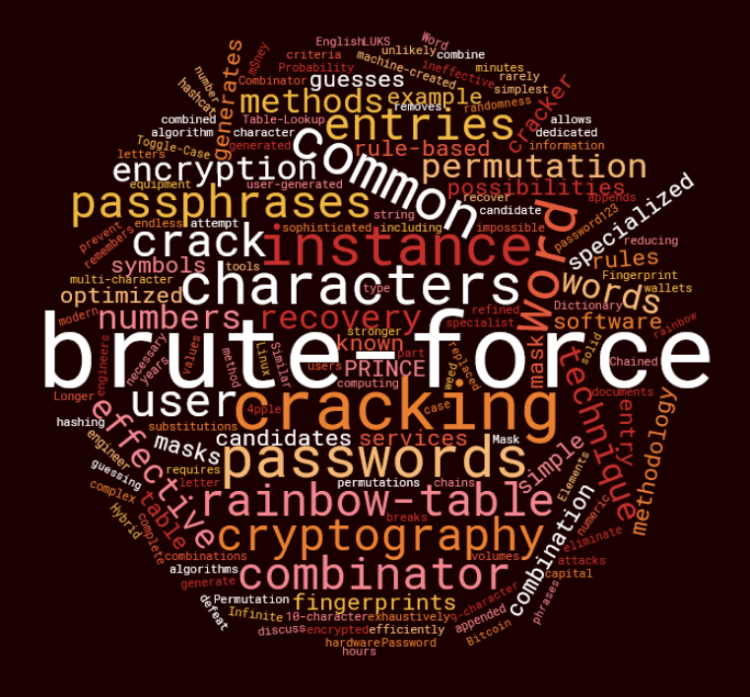
Most Common ways of Password attacks
Dictionary Attack - Uses a list of commonly used passwords to try and gain access to a system. It relies on the assumption that users often choose weak or predictable passwords.
Brute-force Attack - Tries every possible combination of characters until the correct password is found.
Credential Stuffing - An attack where stolen username and password pairs from one breach are used to try and log into other accounts, exploiting password reuse.
Password Spraying - Instead of trying many passwords on one account, this method tries one commonly used password across many accounts. It's designed to avoid triggering account lockouts due to repeated failed attempts.

Slide 4
How are passwords stored on a computer?

Slide 5
Windows
When a password is created, Windows generates a hash of the password using the NT LAN Manager hash algorithm
The generated hash is then encrypted using a key from the system boot key (syskey)
The encrypted hash is stored within the Security Accounts Manager (SAM) file

Slide 6
Linux
When a password is created, Linux hashes it using your distributions configured hashing algorithm (SHA-512, bcrypt, etc)
The password has a random salt added to it before it is hashed so that identical passwords can produce unique hashes
The generated salted hash is stored in the /etc/shadow file which is only accessible by the root user (admin)

Slide 7
What is a hash?
In the context of security and computer storage, a hash algorithm takes data like a password and generates a fixed-length string of numbers called a hash value.
The same input (passwords) will produce the same hash-values which is why additional security like salting and encryption is necessary.
Salting is a process where a random string of characters called the salt, are added to the input before hashing.
Common hashing algorithms – NT Hash, Kerberos, SHA-512, bcrypt, yescrypt

Slide 8
Tools you will be using in the lab
Kali
DVL
John the Ripper
Hashcat
Johnny

Slide 9

Kali
An open-source distribution of Linux geared towards Information Security
Focus on effective penetration testing.
Useful for practicing offensive and defensive tactics such as; vulnerability testing, computer forensics, and red team testing

Slide 10
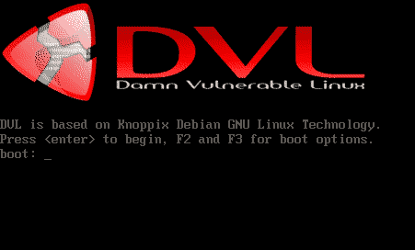
DVL
Also known as “Damn Vulnerable Linux”
Linux distribution geared towards helping students practice cyber security principles
Like the name suggests, it is designed deliberately to be vulnerable to attack

Slide 11

John The Ripper, Hashcat & Johnny
John The Ripper & Hashcat– Password recovery command-line tools used for cracking password hashes
Uses a variety of attacks to obtain the password: dictionary attacks, brute-force, etc.
Can crack hashes produced by many different algorithms including SHA-512, bcrypt, etc.
Johnny - A GUI for John The Ripper
Lets you easily load hash files, adjust cracking settings, and view cracked passwords without having to use the command line.

